Slide 1
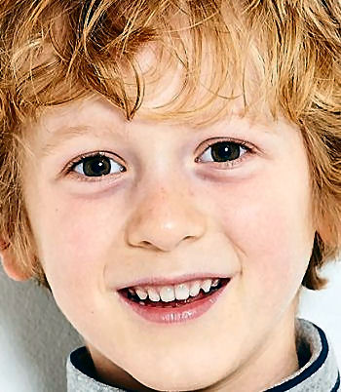
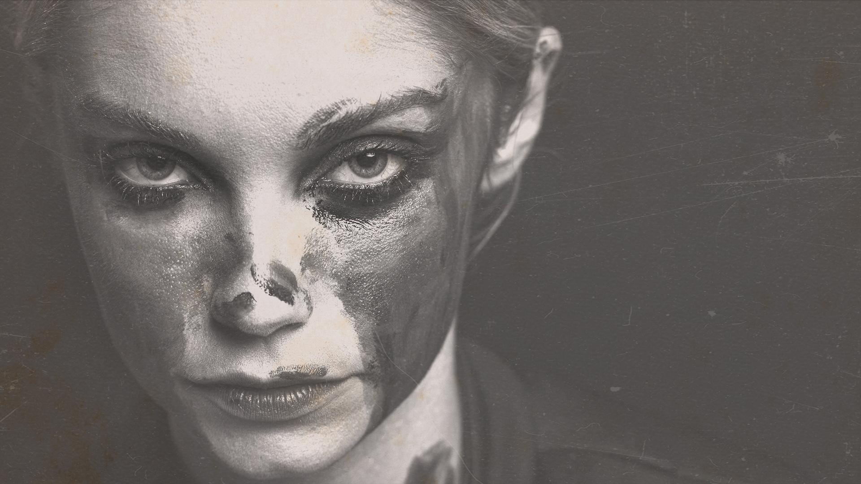
Autism spectrum disorder in children using facial images
SANGEETH.A.P
TVE19MCA048
S6 MCA
Project Guide
Dr.SABITHA S

Slide 2
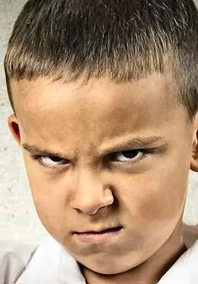
Proposed system
Children diagnosed with autism share common facial feature.
Conducting facial recognition binary classification on images of children.
System uses MobileNet and VGG16 models in order to perform image classification.

Slide 3
Completed till now
Collected the dataset
Created a model with VGG16

Slide 4
To Do
01
02
03
Create MobileNet model
Create a UI
To improve accuracy

Slide 5
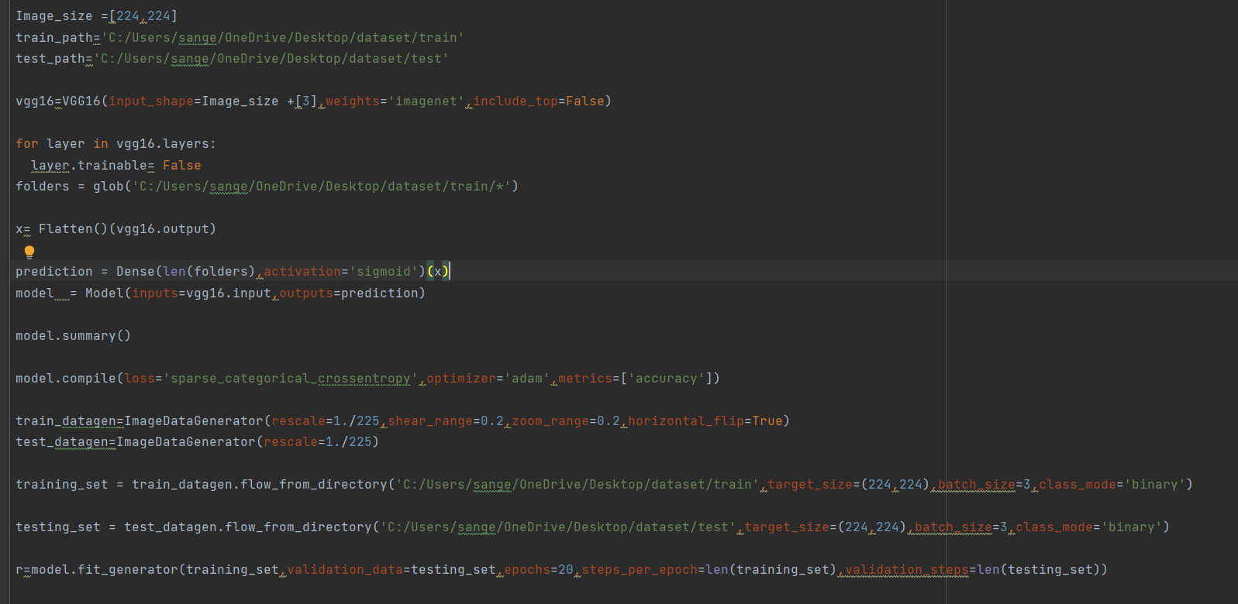

Slide 6
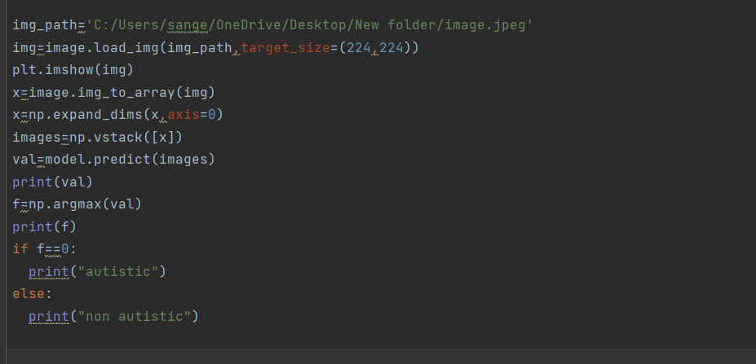

Slide 7
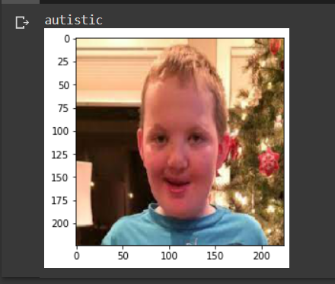

Slide 8
Thank you

